Slide 1
Space Information Website
“Explore the Universe”

Slide 2
TABLE OF CONTENTS
01
02
03
05
INTRODUCTION
Yadav Rohit k.
Roll no:220
Branch:
Roll No:225
Branch: CE
Kapadiya Jay
Roll No:
Branch:
04
EXERCISES
EXERCISES
Roll No:
Branch:
Roll No:
Branch:

Slide 3
Introduction
Welcome to the Space Information Website presentation!
Our website is a gateway to the wonders of the universe, offering a comprehensive exploration of space.
Join us on an exciting journey through the cosmos as we delve into the mysteries of planets, uncover the rich history of space exploration, explore fascinating items used by astronauts, and stay updated with the latest news and discoveries.
Throughout this presentation, we will provide insights into each section of the website, highlighting the wealth of information and resources available for space enthusiasts, students, educators, and anyone with a curious mind.

Slide 4
Sections
01
02
03
Planets
Mission History
04
Items
News And Update

Slide 5
Planets
01
Welcome to the Planets Section of our Space Information Website!
Our solar system is home to an array of fascinating and diverse planets, each with its own unique characteristics and mysteries waiting to be uncovered.
In this section, we will take you on a journey through the wonders of our neighboring planets, from the scorching surface of Mercury to the icy realms of Neptune.

Slide 6
Mission History
02
Humanity's quest to explore the cosmos has been marked by remarkable achievements, daring missions, and groundbreaking discoveries.
In this section, we will take you on a journey through the key milestones and events that have shaped the history of space exploration.
Today, space exploration continues to push the boundaries of human knowledge and capabilities.

Slide 7
Items
03
Space exploration requires a wide range of specialized equipment and tools to ensure the safety and success of missions.
In this section, we will explore some of the key items used by astronauts and spacecraft in their journey through the cosmos.
From spacesuits and helmets to spacecraft and scientific instruments, join us as we uncover the technology and innovation that make space exploration possible.

Slide 8
News and Update!
04
Stay informed about the latest developments and discoveries in space exploration with our News and Updates section!
In this section, we provide regular updates on missions, scientific discoveries, and significant events happening in the world of space exploration.
From new discoveries about distant planets to the launch of cutting-edge spacecraft, our News and Updates section keeps you up-to-date with the latest news from the cosmos.

Slide 9
Components Use
HTML
Java Script
CSS

Slide 10
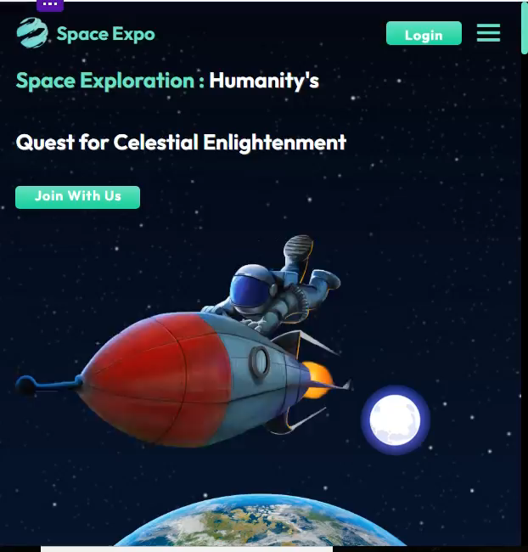
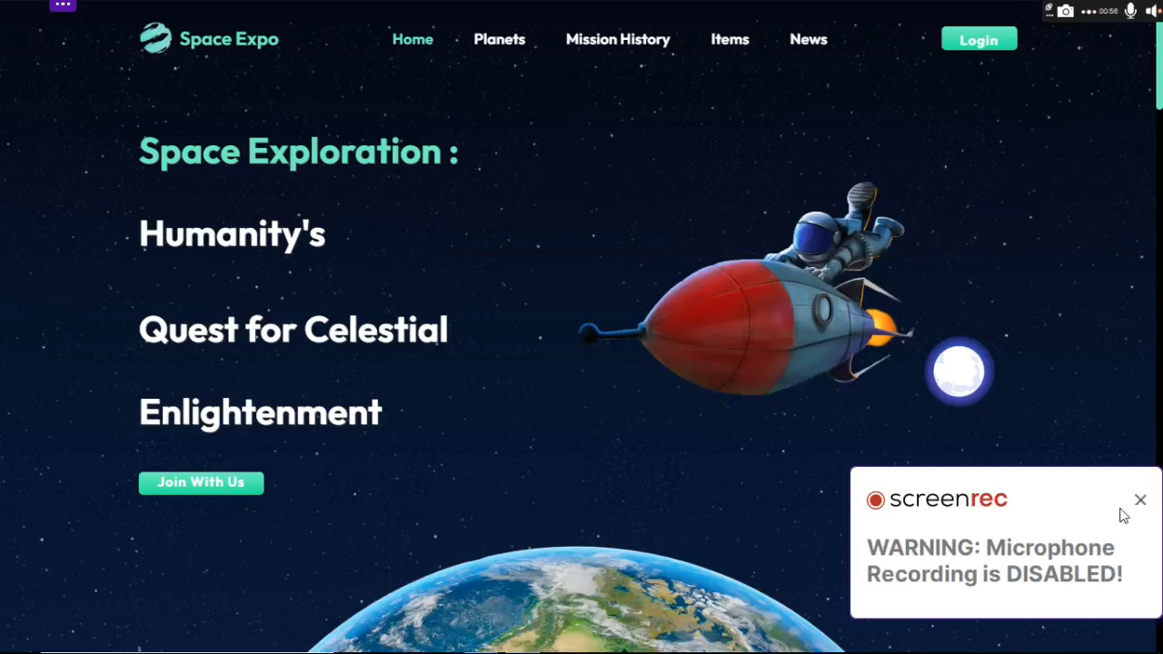
LAPTOP APP
Preview
TABLET APP

Slide 11
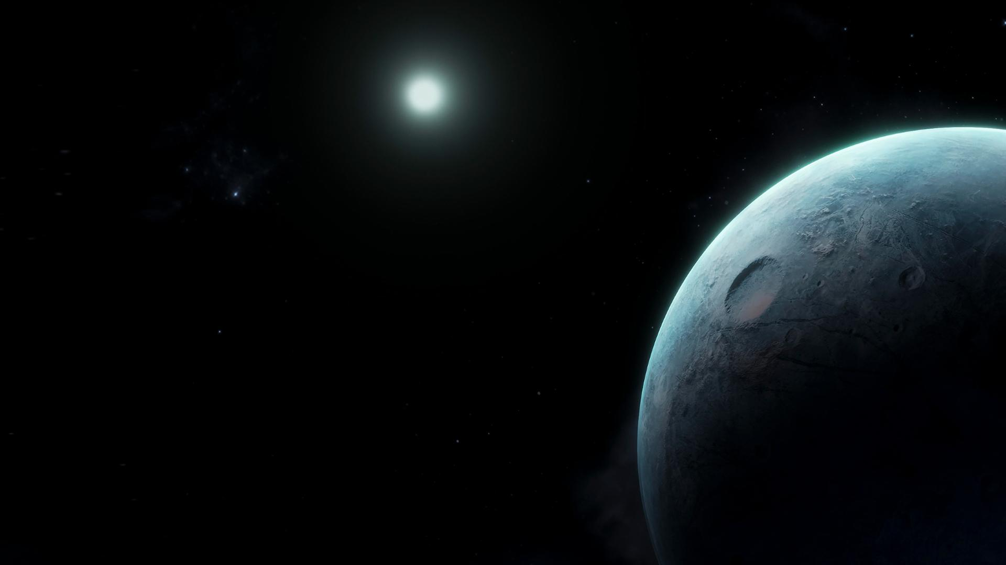
THANK
Y u

